Slide 1
The Design of the Tax System
12
Economics
P R I N C I P L E S O F
N. Gregory Mankiw
Premium PowerPoint Slides by Ron Cronovich
Notes:
In earlier chapters, students learned some important lessons about taxes, including: the effects of a tax on the allocation of resources, tax incidence, and the deadweight loss of a tax.
In this chapter, students will learn about topical policy issues such as:
the so-called “marriage penalty”
the flat tax
income vs. consumption tax
the corporate income tax
Students will also learn the difference between progressive and regressive taxes, marginal and average tax rates, and various criteria for evaluating tax systems.
The chapter begins with a financial overview of the U.S. government. Since the topic here is taxation, this PowerPoint presentation focuses on the revenue side. For additional information on the spending side of the government budget, please refer to the textbook.

Slide 2
In this chapter, look for the answers to these questions:
What are the largest sources of tax revenue in the U.S.?
What are the efficiency costs of taxes?
How can we evaluate the equity of a tax system?
1

Slide 3
Introduction
0
One of the Ten Principles from Chapter 1: A government can sometimes improve market outcomes.
Providing public goods
Regulating use of common resources
Remedying the effects of externalities
To perform its many functions, the govt raises revenue through taxation.
Notes:
2

Slide 4
Introduction
0
Lessons about taxes from earlier chapters:
A tax on a good reduces the market quantity of that good.
The burden of a tax is shared between buyers and sellers depending on the price elasticities of demand and supply.
A tax causes a deadweight loss.
Notes:
3

Slide 5
A Look at Taxation in the U.S.
0
First, we consider:
how tax revenue as a share of national income has changed over time
how the U.S. compares to other countries with respect to taxation
the most important revenue sources for federal, state & local govt
Notes:
4

Slide 6
U.S. Tax Revenue (% of GDP)
0
Notes:
5
As a percentage of GDP, tax revenue has more than doubled since 1940.
Source: Economic Report of the President, 2005.

Slide 7
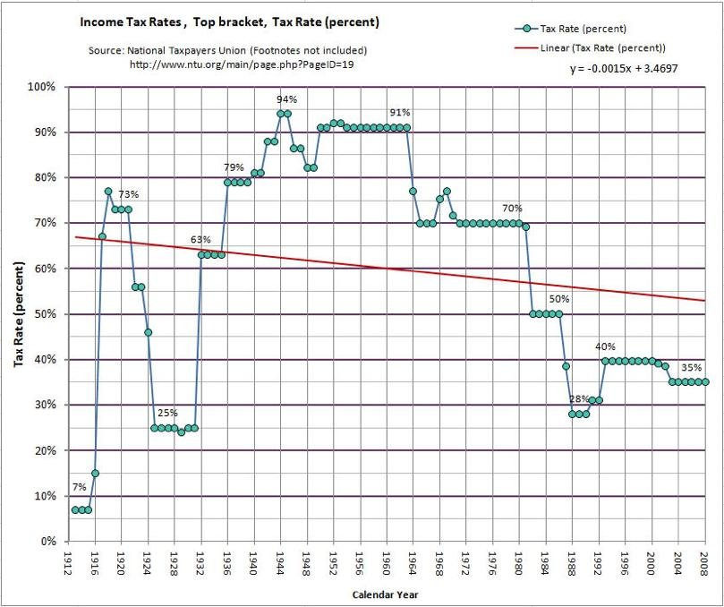
Top Tax Brackets

Slide 8
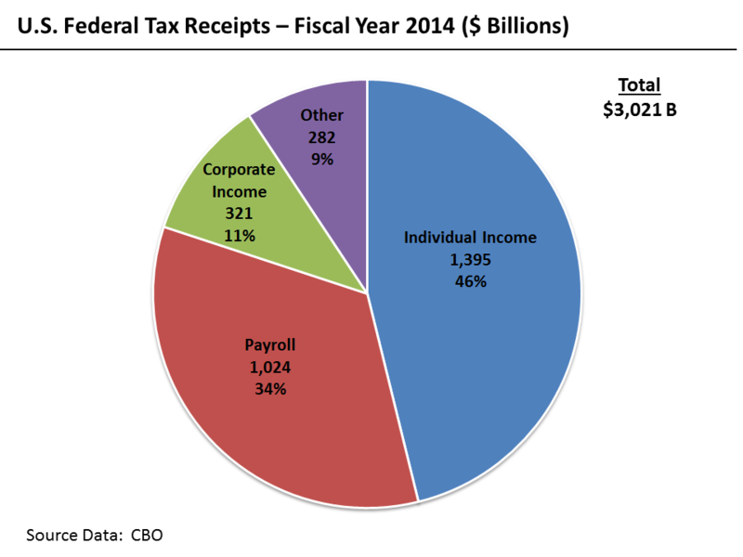

Slide 9
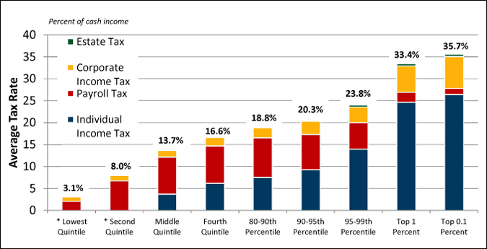

Slide 10
Total Government Revenue (% of GDP)
Sweden | 50%
France | 45
United Kingdom | 37
Germany | 36
Canada | 36
Russia | 32
Brazil | 30
United States | 28
Japan | 27
Mexico | 20
Chile | 19
China | 15
India | 14
0
Notes:
9
Tax revenue (relative to GDP) varies across countries. For the countries included in this table, the U.S. is roughly in the middle. Europe is generally higher, while lower-income countries are generally lower.
source: OECD, United Nations, as reported in forthcoming 5th edition of Principles of Economics, by N. Gregory Mankiw.

Slide 11
Receipts of the U.S. Federal Govt, 2007
0
Tax | Amount (billions) | Amount per person | Percent of receipts
Individual income taxes | $ 1164 | $3,482 | 45.3%
Social insurance taxes | 870 | 2,795 | 33.9
Corporate income taxes | 370 | 1,180 | 14.4
Other | 165 | 572 | 6.4
Total | $2,568 | $8,030 | 100.0%
Notes:
10
The individual income tax is the largest source of revenue for the U.S. federal government.
Social insurance taxes (Social Security, Medicare, etc) run a close second.
Source: Economic Report of the President, 2008 (Table B80, and 2006 population from Table B34)

Slide 12
Receipts of State & Local Govts, 2007
0
Tax | Amount (billions) | Amount per person | Percent of receipts
Sales taxes | $305.1 | $1,010 | 24.1%
Property taxes | 401.3 | 1,329 | 31.7
Individual income taxes | 291.7 | 966 | 23.0
Corporate income taxes | 58.0 | 192 | 4.6
Other | 211.7 | 701 | 16.7
Total | $1,268 | $4,197 | 100.0%
Notes:
11
The most important revenue sources for state and local governments are funds from the federal government and revenue from sales and property taxes. Income taxes are also important in many states.
Source: Department of Commerce, Bureau of the Census. “Federal, State, and Local Governments Quarterly Summary of State and Local Government Tax Revenue.” Table 1.
http://www.census.gov/govs/www/qtax.html
Note: “Other” includes taxes on gas and alcoholic beverages, drivers license fees, and “all other.”
Note: The corresponding table in the textbook and in last year’s edition of this PowerPoint presentation included “from federal government” as an additional category of state and local receipts. The data source used was the Economic Report of the President. In preparing this 2008 update, I checked the 2008 ERP and it does not update the state and local government receipts data: the most recent in the ERP is still from 2005. I found 2007 data at the Census Bureau website (URL given above), but it didn’t include the revenues states and local governments receive from the federal government. If you wish, you can tell your students that states and local governments receive funds from the federal government amounting to approximately 23% of their total receipts (the 23% is as of 2005 – it’s probably different now, but not much).

Slide 13
Taxes and Efficiency
0
One tax system is more efficient than another if it raises the same amount of revenue at a smaller cost to taxpayers.
The costs to taxpayers include:
the tax payment itself
deadweight losses
administrative burden
Notes:
12

Slide 14
Deadweight Losses
0
One of the Ten Principles: People respond to incentives.
Recall from Chapter 8: Taxes distort incentives, cause people to allocate resources according to tax incentives rather than true costs and benefits.
The result: a deadweight loss. The fall in taxpayers’ well-being exceeds the revenue the govt collects.
Notes:
13
Deadweight loss was covered extensively in Chapter 8. Any students needing review should read the brief example at this point in Chapter 12, which very clearly recaps the idea of a deadweight loss from taxation in the context of a simple example.

Slide 15
Income vs. Consumption Tax
0
The income tax reduces the incentive to save:
If income tax rate = 25%, 8% interest rate = 6% after-tax interest rate.
The lost income compounds over time.
Some economists advocate taxing consumption instead of income.
Would restore incentive to save.
Better for individuals’ retirement income security and long-run economic growth.
Notes:
14
The material on this slide corresponds to a case study in the chapter.
See the textbook for a dramatic example of the income tax disincentive to saving.

Slide 16
Income vs. Consumption Tax
0
Consumption tax-like provisions in the U.S. tax code include Individual Retirement Accounts, 401(k) plans.
People can put a limited amount of saving into such accounts.
The funds are not taxed until withdrawn at retirement.
Europe’s Value-Added Tax (VAT) is like a consumption tax.
Notes:
15

Slide 17
Administrative Burden
0
Includes the time and money people spend to comply with tax laws
Encourages the expenditure of resources on legal tax avoidance
e.g., hiring accountants to exploit “loopholes” to reduce one’s tax burden
Is a type of deadweight loss
Could be reduced if the tax code were simplified
but would require removing loopholes, politically difficult
Notes:
16

Slide 18
Marginal vs. Average Tax Rates
0
Average tax rate
total taxes paid divided by total income
measures the sacrifice a taxpayer makes
Marginal tax rate
the extra taxes paid on an additional dollar of income
measures the incentive effects of taxes on work effort, saving, etc.
Notes:
17

Slide 19
Lump-Sum Taxes
0
A lump-sum tax is the same for every person
Example: lump-sum tax = $4000/person
Income
Average tax rate
Marginal tax rate
$20,000
20%
0%
$40,000
10%
0%
Notes:
18

Slide 20
Lump-Sum Taxes
0
A lump-sum tax is the most efficient tax:
Causes no deadweight loss Does not distort incentives.
Minimal administrative burden No need to hire accountants, keep track of receipts, etc.
Yet, perceived as unfair:
In dollar terms, the poor pay as much as the rich.
Relative to income, the poor pay much more than the rich.
Notes:
19

Slide 21
Taxes and Equity
0
Another goal of tax policy: equity – distributing the burden of taxes “fairly.”
Agreeing on what is “fair” is much harder than agreeing on what is “efficient.”
Yet, there are several principles people apply to evaluate the equity of a tax system.
Notes:
20

Slide 22
The Benefits Principle
0
Benefits principle: the idea that people should pay taxes based on the benefits they receive from govt services
Tries to make public goods similar to private goods – the more you use, the more you pay
Example: Gasoline taxes
Amount of tax paid is related to how much a person uses public roads
Notes:
21

Slide 23
The Ability-To-Pay Principle
0
Ability-to-pay principle: the idea that taxes should be levied on a person according to how well that person can shoulder the burden
Suggests that all taxpayers should make an “equal sacrifice”
Recognizes that the magnitude of the sacrifice depends not just on the tax payment, but on the person’s income and other circumstances
a $10,000 tax bill is a bigger sacrifice for a poor person than a rich person
Notes:
22

Slide 24
Vertical Equity
0
Vertical equity: the idea that taxpayers with a greater ability to pay taxes should pay larger amounts
Notes:
23

Slide 25
Three Tax Systems
0
Proportional tax: Taxpayers pay the same fraction of income, regardless of income
Regressive tax: High-income taxpayers pay a smaller fraction of their income than low-income taxpayers
Progressive tax: High-income taxpayers pay a larger fraction of their income than low-income taxpayers
Notes:
24

Slide 26
Examples of the Three Tax Systems
0
Regressive
Proportional
Progressive
income
tax
% of income
tax
% of income
tax
% of income
$50,000
$15,000
30%
$12,500
25%
$10,000
20%
100,000
25,000
25
25,000
25
25,000
25
200,000
40,000
20
50,000
25
60,000
30
Notes:
25
This slide replicates Table 7 in the textbook.
Point out that even a regressive income tax satisfies vertical equity, as vertical equity only requires that the dollar amount of taxes rise with income, not the average tax rate.

Slide 27
U.S. Federal Income Tax Rates: 2007
0
The U.S. has a progressive income tax.
On taxable income… | the tax rate is…
0 – $7,825 | 10%
7,825 – 31,850 | 15%
31,850 – 77,100 | 25%
77,100 – 160,850 | 28%
160,850 – 349,700 | 33%
Over $349,700 | 35%
Notes:
26
The tax rates in this table are for single filers. Source: www.irs.gov.
Note on interpreting the table: The tax rates shown are marginal tax rates that apply only to income in the corresponding brackets. For example, a person earning $30,000 would pay 10% on the first $7825 of income, and 15% on income above $7825. He would not pay 15% on his ENTIRE income.
As the table shows, the U.S. income tax is progressive. This table excludes transfer payments, which accrue mainly to lower income persons. Factoring in transfer payments, the system looks even more progressive.

Slide 28
Horizontal Equity
0
Horizontal equity: the idea that taxpayers with similar abilities to pay taxes should pay the same amount
Problem: Difficult to agree on what factors, besides income, determine ability to pay.
Notes:
27

Slide 29
A C T I V E L E A R N I N G 1 Taxes and Marriage, part 1
The income tax rate is 25%. The first $20,000 of income is excluded from taxation. Tax law treats a married couple as a single taxpayer.
Sam and Diane each earn $50,000.
i. If Sam and Diane are living together unmarried, what is their combined tax bill?
ii. If Sam and Diane are married, what is their tax bill?
28

Slide 30
A C T I V E L E A R N I N G 1 Answers
If unmarried, Sam and Diane each pay 0.25 x ($50,000 – 20,000) = $7500
Total taxes = $15,000 = 15% of their joint income.
If married, they pay 0.25 x ($50,000 – 20,000) = $20,000 or 20% of their joint income.
The $5000 increase in the tax bill is called the “marriage tax” or “marriage penalty.”
29
Notes:
In this exercise, Sam and Diane’s problem arises because, as singles, each enjoys a $20,000 income exclusion, so the first $40,000 of their combined income is excluded from taxes. As a married couple, only the first $20,000 of income is excluded.
One way to fix this is to double the exclusion for married couples relative to single tax filers. But doing so causes another problem, as we will see in the second part of this exercise…

Slide 31
A C T I V E L E A R N I N G 2 Taxes and Marriage, part 2
The income tax rate is 25%. For singles, the first $20,000 of income is excluded from taxation. For married couples, the exclusion is $40,000.
Harry earns $0. Sally earns $100,000.
i. If Harry and Sally are living together unmarried, what is their combined tax bill?
ii. If Harry and Sally are married, what is their tax bill?
30
Notes:
Here, we have changed the tax code to eliminate the marriage penalty that couples like Sam and Diane face: we have doubled the exclusion for married couples.
However, this creates a different kind of problem for other couples, as students will learn when they work through this exercise.

Slide 32
A C T I V E L E A R N I N G 2 Answers
If unmarried, Harry pays $0 in taxes. Sally pays 0.25 x ($100,000 – 20,000) = $20,000
Total taxes = $20,000 = 20% of their joint income.
If married, they pay 0.25 x ($100,000 – 40,000) = $15,000 or 15% of their joint income.
The $5000 decrease in the tax bill is called the “marriage subsidy.”
31

Slide 33
Marriage Taxes and Subsidies
0
In current U.S. tax code,
couples with similar incomes are likely to pay a marriage tax
couples with very different incomes are likely to receive a marriage subsidy
Many have advocated reforming the tax system to be neutral with respect to marital status…
Notes:
32

Slide 34
Marriage Taxes and Subsidies
0
The ideal tax system would have these properties:
Two married couples with the same total income pay the same tax.
Marital status does not affect a couple’s tax bill.
A person/family with no income pays no taxes.
High-income taxpayers pay a higher fraction of their incomes than low-income taxpayers.
However, designing a tax system with all four of these properties is mathematically impossible.
Notes:
33
The first two of these four properties relate to horizontal equity.
The last two relate to vertical equity.

Slide 35
Tax Incidence and Tax Equity
0
Recall: The person who bears the burden is not always the person who gets the tax bill.
Example: A tax on fur coats
May appear to be vertically equitable
But furs are a luxury with very elastic demand
The tax shifts demand away from furs, hurting the people who produce furs (who probably are not rich)
Lesson: When evaluating tax equity, must take tax incidence into account.
Notes:
34

Slide 36
Who Pays the Corporate Income Tax?
0
When the govt levies a tax on a corporation, the corporation is more like a tax collector than a taxpayer.
The burden of the tax ultimately falls on people.
Suppose govt levies a tax on automakers.
Owners receive less profit, may respond over time by shifting their wealth out of the auto industry.
The supply of cars falls, car prices rise, car buyers are worse off.
Demand for auto workers falls, wages fall, workers are worse off.
Notes:
35
The corporate income tax is popular among voters. After all, corporations are not people. Voters are always eager to have their taxes reduced and have some faceless corporation pick up the tab.
But if the true incidence of the corporate income tax were widely understood, it might be much less popular.

Slide 37
Flat Taxes
0
Flat tax: a tax system under which the marginal tax rate is the same for all taxpayers
Typically, income above a certain threshold is taxed at a constant rate
The higher the threshold, the more progressive the tax
Radically reduces administrative burden
Not popular with
people who benefit from the complexity of the current system (accountants, lobbyists)
people who can’t imagine life without their favorite deduction/loophole
Used in some central/eastern European countries
Notes:
36
This material is based on a 2005 Economist article entitled “The Flat Tax Revolution.” This article appeared in the previous edition of the textbook in an “In the News” box.

Slide 38
CONCLUSION: The Trade-Off Between Efficiency and Equity
0
The goals of efficiency and equity often conflict:
E.g., lump-sum tax is the least equitable but most efficient tax.
Political leaders differ in their views on this tradeoff.
Economics
can help us better understand the tradeoff
can help us avoid policies that sacrifice efficiency without any increase in equity
Notes:
37

Slide 39
CHAPTER SUMMARY
In the U.S., the most important federal revenue sources are the personal income tax, social insurance payroll taxes, and the corporate income tax. The most important state and local taxes are the sales tax and property tax.
The efficiency of a tax system refers to the costs it imposes on taxpayers beyond their tax payments. One cost is the deadweight loss caused by the distortion of incentives from taxes. Another is the administrative burden of complying with tax laws.
38

Slide 40
CHAPTER SUMMARY
The equity of a tax system refers to its fairness. The benefits principle suggests that it is fair for people to be taxed based on the amount of government benefits they receive. The ability-to-pay principle suggests that it is fair for people to pay taxes based on their ability to handle the burden.
The U.S. has a progressive tax system, in which high income taxpayers face a higher average tax rate than low income taxpayers.
39

Slide 41
CHAPTER SUMMARY
When evaluating the equity of a tax system, it is important to consider tax incidence, as the distribution of tax burdens is not the same as the distribution of tax bills.
Policymakers often face a tradeoff between the goals of efficiency and equity in the tax system. Much of the debate over tax policy arises because people give different weights to these two goals.
40

